Slide 1
E-Commerce Customer Support Assistant
HITESHI AGLAWE

Slide 2
🛒 NovaCart AI Assistant
(Agentic AI Chatbot for Customer Support)
Aim:
Automate 70–80% of routine queries using AI while still allowing human escalation
Tech Stack: LangGraph | LangChain | FastAPI | Streamlit | RAG | SQLite

Slide 3
Problem Statement
❓The Problems..
E-commerce platforms need efficient and scalable customer support systems to manage the growing volume of user queries.
Traditional E-commerce support systems fail to scale safely due to non-agentic chatbots, poor escalation, and lack of measurable AI performance.
🎯 Goal..
Build an agentic AI assistant for e-commerce that autonomously resolves customer issues using LLMs, RAG, and tools. It supports secure, stateful multi-turn conversations with safe fallbacks and human escalation.

Slide 4
OBJECTIVES
Build an agentic AI support chatbot
Handle multi-task customer workflows conversationally
Ensure safe, non-hallucinating responses
Support multi-turn, stateful conversations
Deterministic routing
Measure performance using Evaluation metrics

Slide 5
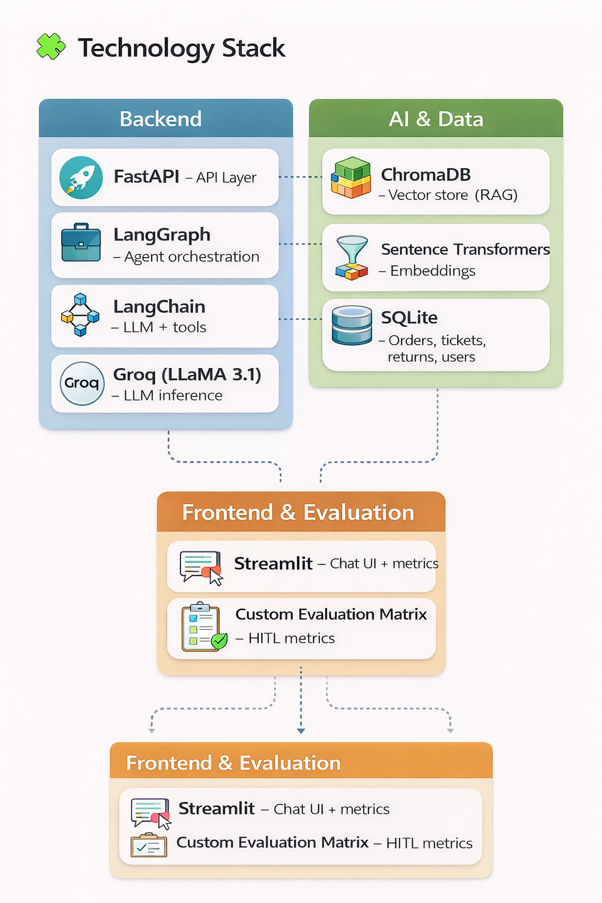
TECHNOLOGY STACK
FastAPI
LangGraph
LangChain
Groq (LLaMA 3.1)
ChromaDB
Sentence Transformers
SQLite –Streamlit

Slide 6
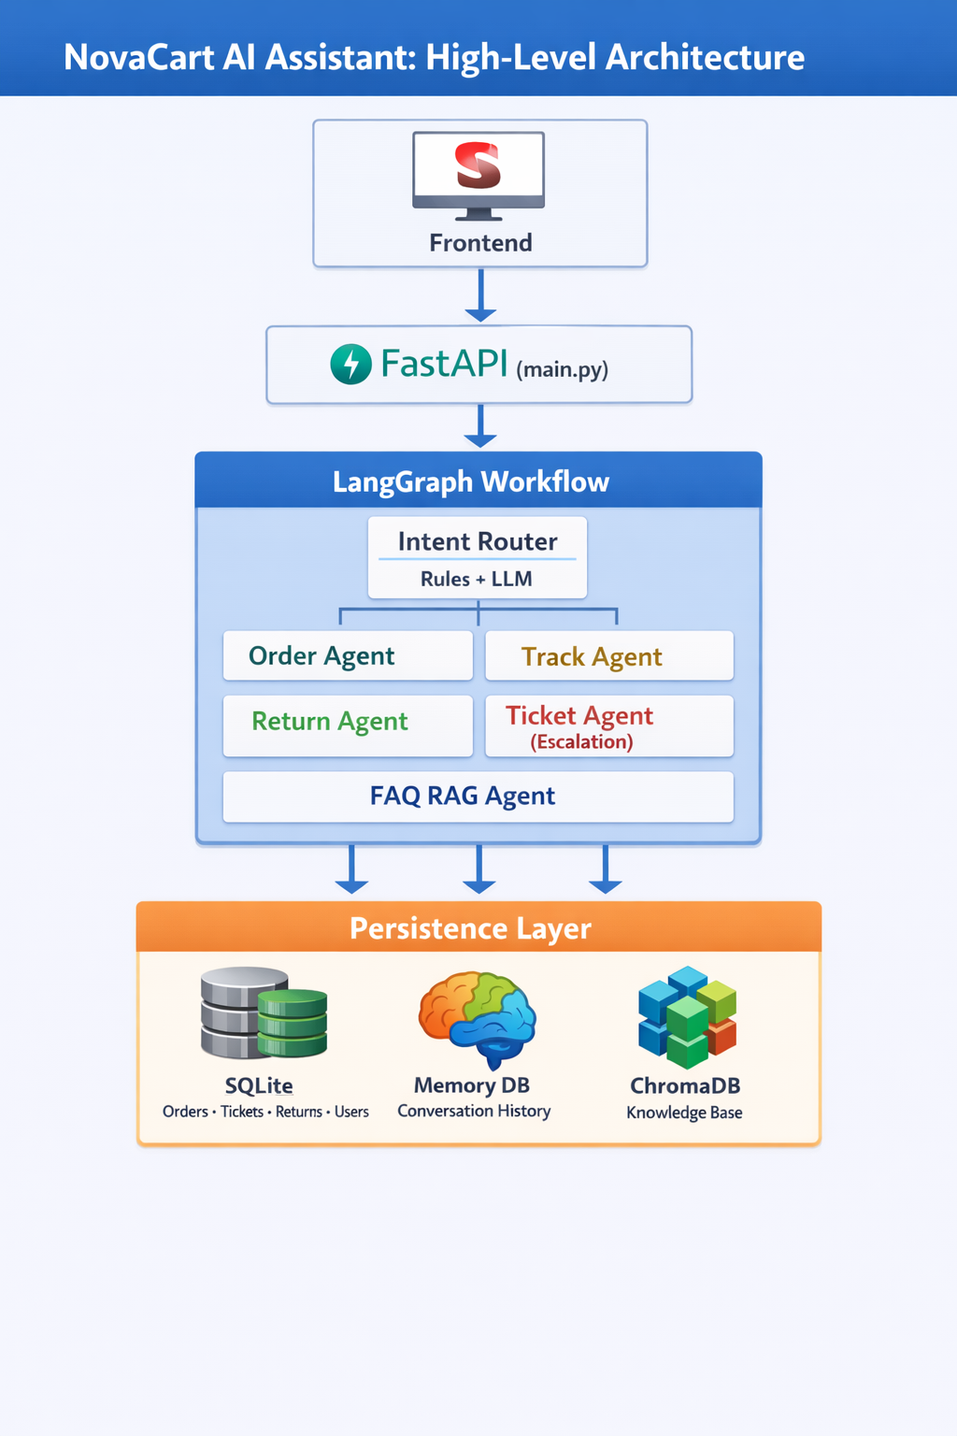
SYSTEM ARCHITECTURE

Slide 7
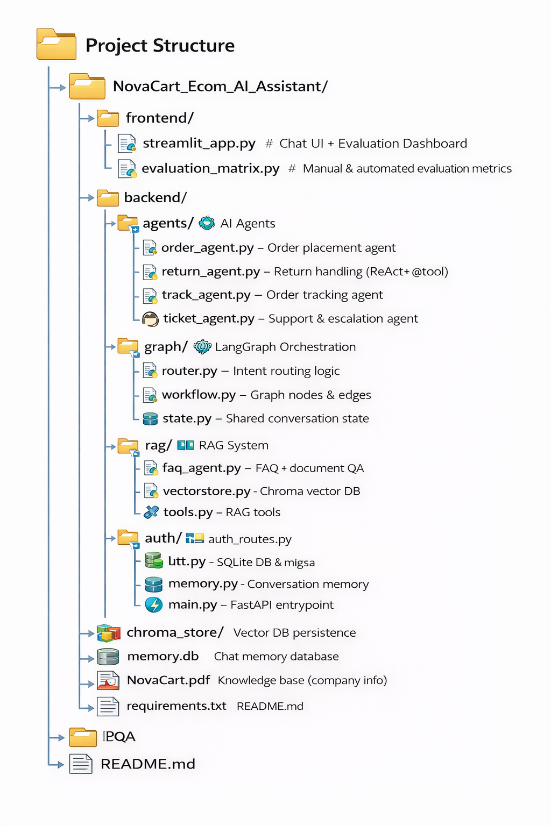
PROJECT’S FILE STRUCTURE

Slide 8
Authentication & Sessions
Features
Signup / Login
Persistent user_id
Session-based conversations
Secure order ownership checks
Ensures: ✔ User isolation ✔ No cross-user data leakage

Slide 9
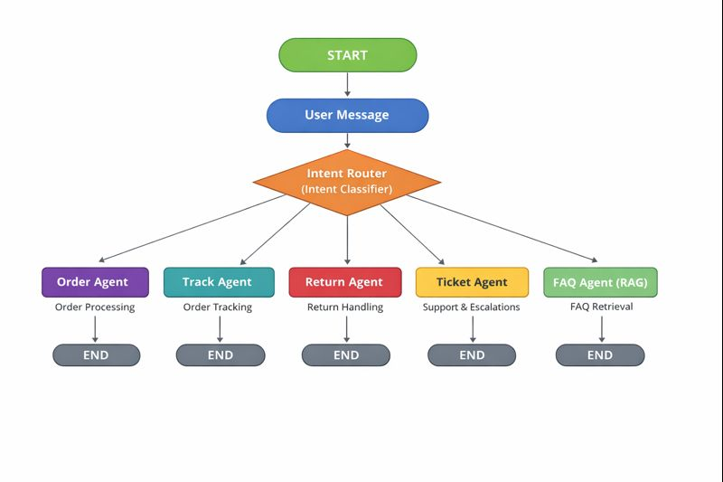
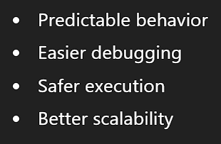
LangGraph Workflow (Core Brain)
Why LangGraph?
Traditional LLM chains:
Are linear
Break on edge cases
Good for experimental chains
LangGraph provides:
Deterministic routing
Stateful transitions
Multi-agent orchestration
Prevention of Infinite Loops/ controlled flow
Production-grade

Slide 10
Memory & State Management
Stored in Conversation State
Messages
User ID
Session ID
Active order ID
Pending intent
Escalation reason
Persistence
SQLite Orders DB
Conversational memory storage
Prevents context bloat

Slide 11
INTENT ROUTER
Responsibilities
Detect user intent (order, track, return, FAQ, ticket)
Extract order IDs (ORD-XXXX)
Handle partial inputs across turns
Store: (a) active_order_id, (b) pending_intent
Detect escalation triggers
Design Principle
Rules and LLM both
✔ Faster, ✔ Safer, ✔ Predictable

Slide 12
AI AGENTS OVERVIEW
Each agent:
Has clear responsibility
Uses tools for DB actions
Uses LLM for reasoning, Natural language understanding and entity extraction
AGENT | RESPONSIBILITY
Order Agent | Place new orders
Track Agent | Track delivery & ETA
Return Agent | Handle returns
Ticket Agent | Support + escalation
FAQ Agent | Company policy Q&A

Slide 13
Prompting Used
PROMPTING TECHNIQUE | PURPOSE | WHERE USED
Instruction Prompting | Define role | Agents, FAQ Agent
Structured Output | Reliable parsing | Order, Ticket, Return
Guardrail Prompting | Enforce rules | FAQ Agent/ agents
Context Injection | Multi-turn flow | Agents
Fallback Prompting | Robustness | All agents
RAG Prompting | Knowledge grounding | FAQ Agent

Slide 14
Order Agent
Track Agent
Feature and Tools :
Extracts product & quantity using LLM
Validates inputs @tool
Creates order in DB @tool
Returns confirmation
LLM used for:
Natural language understanding and Entity extraction
Feature and Tools :
Fetches order from DB @tool
Computes delivery ETA (5–7 business days)
Explains status to user
LLM used only for:
Friendly explanation
User-facing language

Slide 15
Return Agent
Ticket Agent
Features and Tools:
Uses LLM to extract return reason
Validates order ownership @tool
Prevents duplicate return requests : (Guard Condition)
If order status is already present:
“Return has already been initiated.”
Updates order + returns table @tool
✔ Shows the real-world behavior
LLM used for:
Natural language understanding and Entity extraction
Features and Tools:
Creates support ticket @tool
Generated unique ticket id
Updates status as ESCALATED
Escalation:
User explicitly asks for human
Low confidence response
LLM used for:
Natural language understanding and Entity extraction

Slide 16
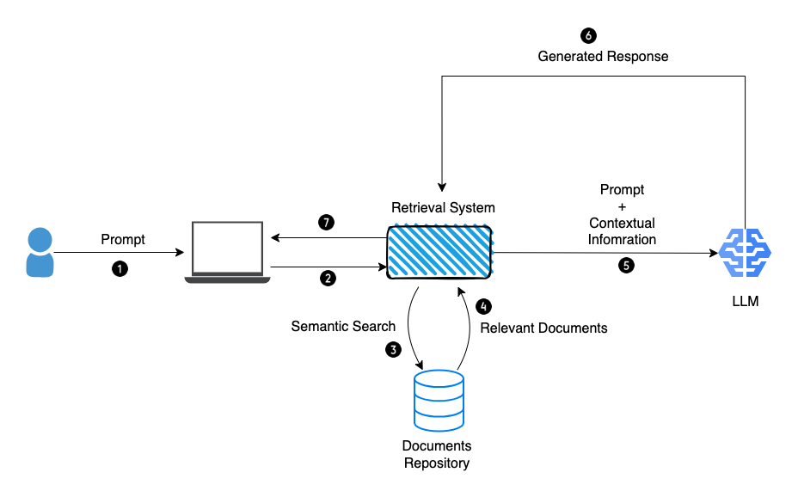
FAQ Agent (RAG System)
Knowledge Source
NovaCart_Enhanced.pdf
Company policies @tool
FAQs
Returns & shipping rules
RAG Design
ChromaDB
MMR retrieval
Forced summarization
No hallucinations
If answer not found:
“This information is not available in our documents.”

Slide 17
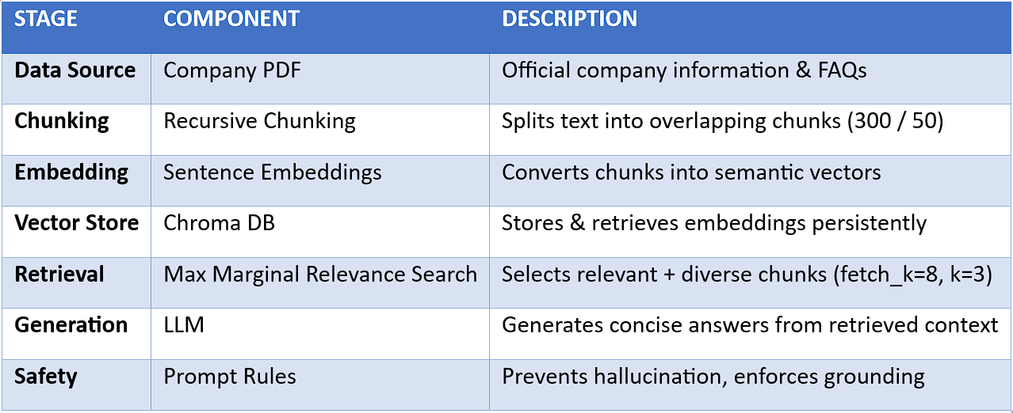

Slide 18
Evaluation Matrix & Evaluation Dashboard
Why Evaluation Matters
Most chatbots: ❌ No quality metrics ❌ No feedback loop
Metrics Implemented
Intent Accuracy (Human I/P)
Response Rating (1–5) (Human I/P)
Task Success Rate (Human I/P)
Confidence Score (Bot generated)
Features
Manual evaluation per interaction
Confidence vs accuracy graph
CSV export
Human feedback loop
📌 Enables continuous AI improvement

Slide 19
FUTURE SCORE
Additions :
Voice support (webRTC LiveKit / Twilio)
Product catalog scraping
Payment & refund simulation (Tool Extensibility)
MCP server integration
Observability
Betterments :
Better Memory database usage
Intent-Aware + Contextual Semantic Search (session memory + embeddings)
Smarter Human Escalation (HITL 2.0)
Advanced Evaluation & Analytics

Slide 20
Thank You!

